Slide 1
BEHAVIOURAL ANALYSIS OF RURAL WORKING WOMEN
BUVITHA. B (22PCP815)
RESEARCH GUIDE- Dr. A. John Balaiah.

Slide 2



RESEARCH PLAN
INTRODUCTION
REVIEW OF LITERATURE
DATA COLLECTION AND METHODOLOGY
ANALYSIS OF DATA
CONCLUSION

Slide 3

WHY THIS TOPIC?
Keen Interest
in organisational sector
To explore work from women’s perspective
Very few knowledge about rural working conditions
To find the overall effect of work in
life

Slide 4
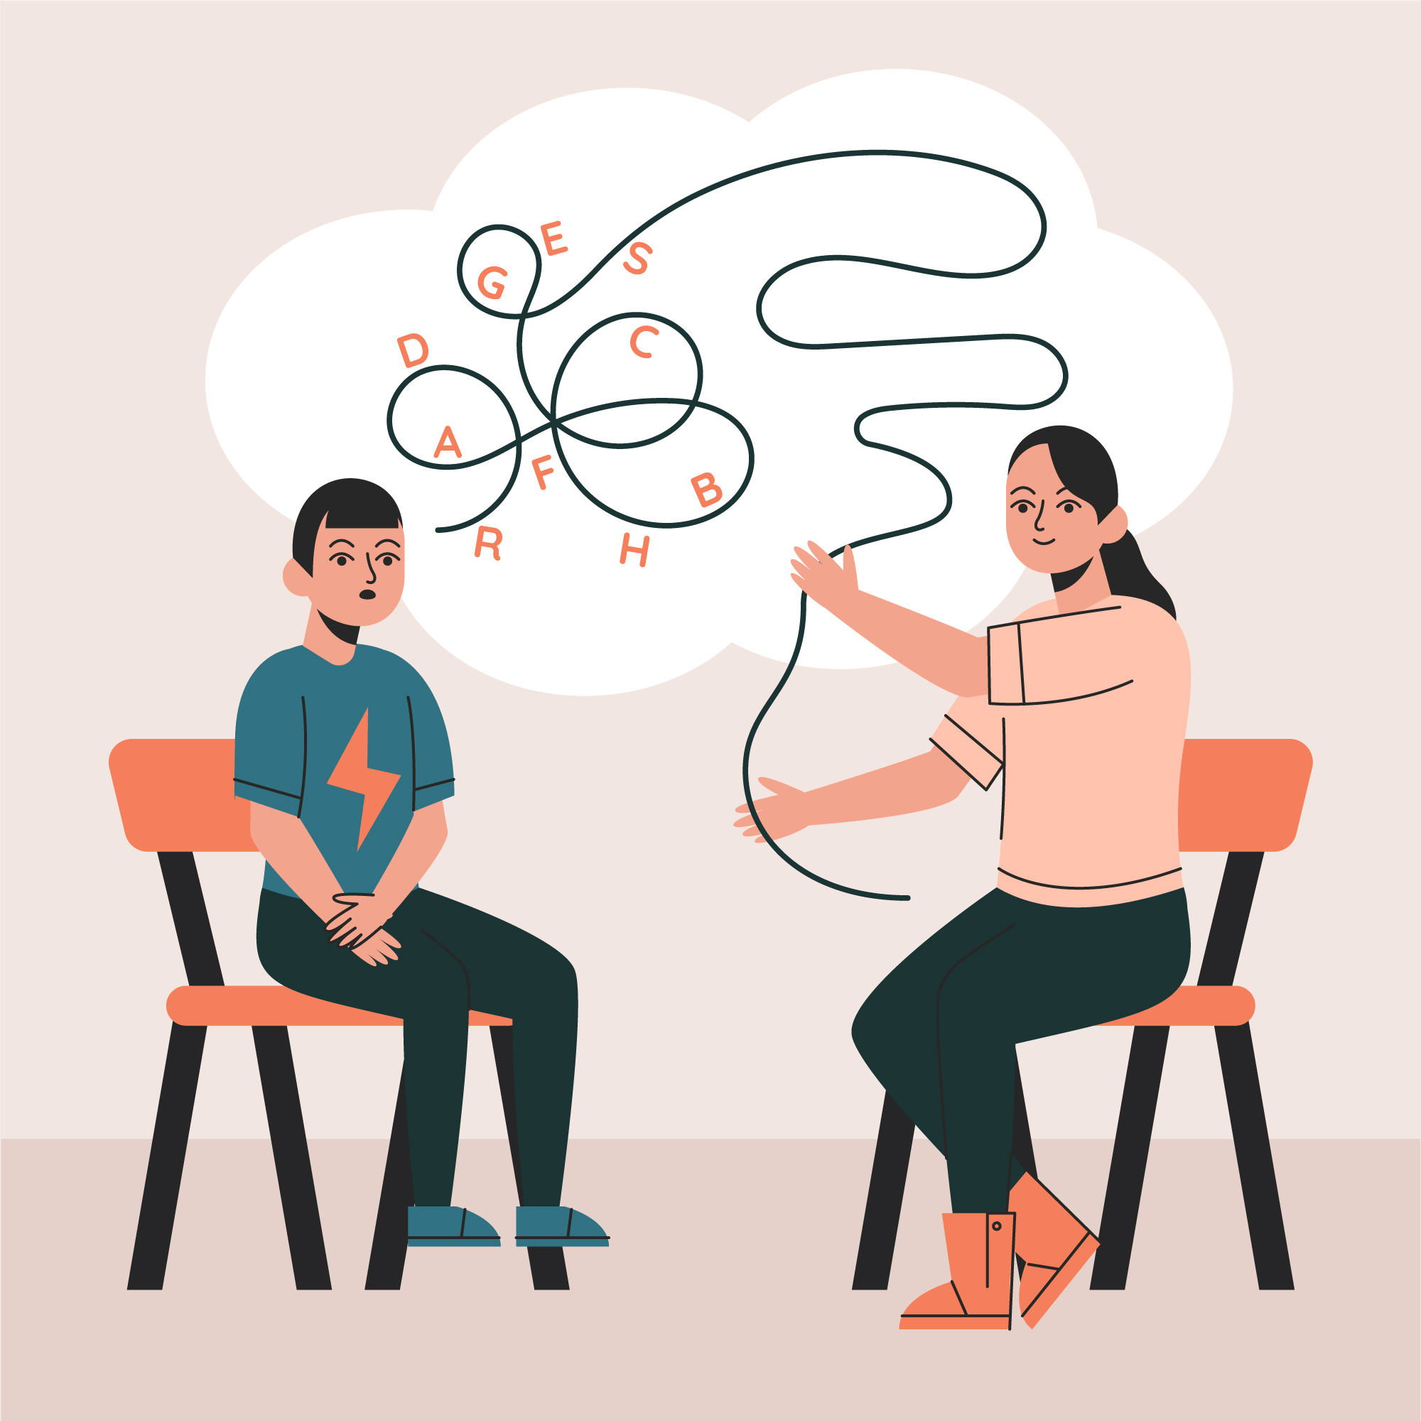
CHAPTER I & ii
CHAPTER 1
The introduction consists of the growth in condition of women.
Bio psycho social factors, gender roles and the professional behaviour are explained
REBT is chosen as the theoretical orientation
CHAPTER 2
The review of literature consists of the various studies which relates to the autonomy of working women, work and family conflict, satisfaction with life, quality of life and work life balance.

Slide 5

STUDY VARIABLES
02
01
03
WORK-FAMILY-CONFLICT
SATISFACTION WITH LIFE
An inter-role conflict where work and family mututually pressures each other.
AUTONOMY
The overall wellbeing with life.
The control one posses while taking decisions.

Slide 6
oBJECTIVES
RESEARCH STATEMENT
The researcher will study the behavioural characteristics of rural working women by applying REBT and consolidate the significant role of working women for the development of nation
RESEARCH OBJECTIVES
• To study the various behaviours of working women.
• To explore the relevance of REBT
• To analyse the behaviours of working women concerning Satisfaction with life, internal locus of control(autonomy), work, and family conflict.
• To suggest strategies and to improve the quality of work and life of working women.
HYPOTHESIS
There is a significant relationship between the working women’s work and life conditions.
There is an impact of REBT on the growth and development of working women.

Slide 7
Chapter iii
It is a qualitative research and the samples were collected through convenience sampling method.
The survey method was used to collect the data.
A questionnaire was prepared with the tools Satisfaction with Life Scale, Ryff Scales of Psychological Well-being Scale, Work and Family Conflict Scale. This questionnaire was circulated in the target company.
Population- Rural working women
Sample- 150 women
Descriptive statistics, chi-square, and correlation method was used to analyse the data.

Slide 8
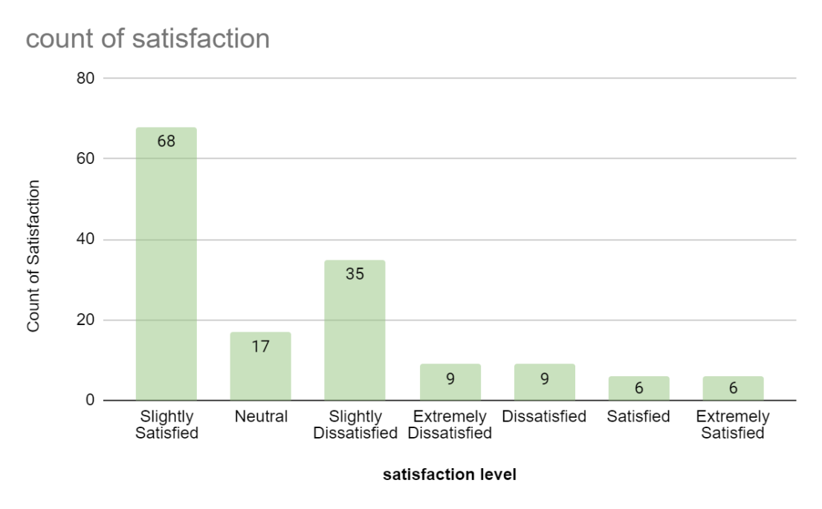
Chapter iv- result
The findings include that 45.3% of the women were slightly satisfied with their life. 23.3% were slightly dissatisfied. Overall, 53.3% of the women were satisfied with their life and 35.3% were dissatisfied with their lives. The remaining people were recorded neutral.

Slide 9
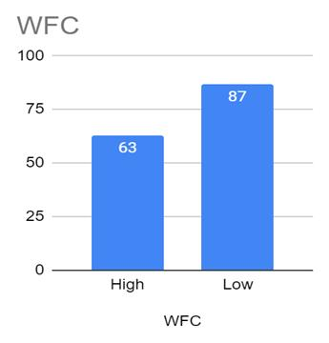
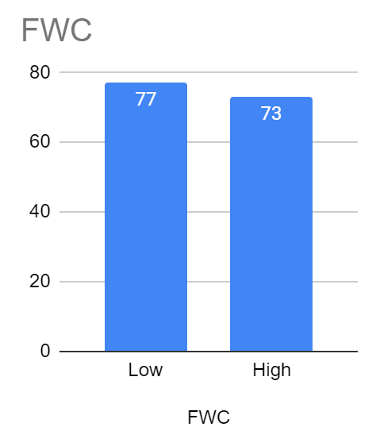
CHAPTER IV- result
The women reported high levels of family-to-work conflict. The direction of conflict is higher from family to work. They showed a negative association with satisfaction with life.

Slide 10
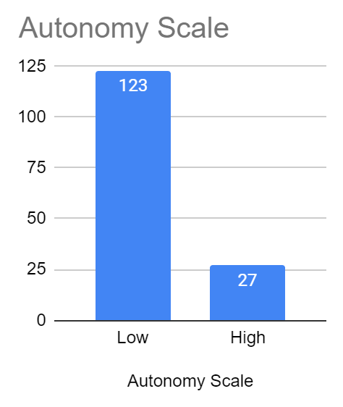
Chapter iv- result
This research shows that 123 (82%) of the people do not perceive them as autonomic people. Only 27(18%) of the sample considered themselves as autonomic.
Autonomy and satisfaction with life are positively correlated. Interestingly, Autonomy and work-to-family conflict are positively correlated.

Slide 11

Chapter iv- FINDINGS
OTHER KEY FINDINGS
The age and satisfaction with life are related.
Educational qualification and work-to-family conflict are related.
Position and satisfaction with life are related.
Position and work-family conflict are related.
Experience in the company and work-family conflict are related.
Income level and satisfaction with life are related.
Income level and autonomy are related.

Slide 12
CHAPTER V- FINDINGS - REBT INTERVENTIONS
To increase autonomy levels- COGNITIVE TECHNIQUES
~REBT self-help form ~Reverse role-playing ~Reframing
To handle family to work conflict- EMOTIVE AND BEHAVIOURAL TECHNIQUES
~Guided imagery ~Paradoxical behaviour
To increase satisfaction with life- EMOTIVE, COGNITIVE AND BEHAVIOURAL TECHNIQUES
~Non dogmatic preferences ~Paradoxical behaviour ~High frustration tolerance ~Disputing ~no globally rating self/other

Slide 13

Chapter v- conclusion
CONCLUSION
There is a significant relationship between working women’s work and life.
The variables satisfaction with life, work and family conflict, and autonomy are related.
REBT can be used in improving the life of working women.
LEARNING
Work enhances the lives of women. The society and nation develops.
The use of REBT can be tailored according to the needs of the client and enhance their functioning.

